Slide 1
SORTING ALGORITHMS
SORTING ALGORITHMS CODE IN PYTHON AND PLOTTING TIME V/S INPUT GRAPH USING MATPLOTLIB

Slide 2

WHAT IS SORTING ?

Slide 3
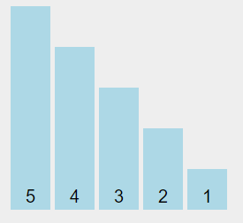
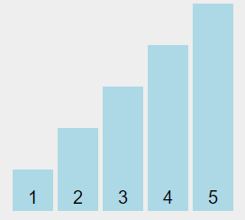

UNSORTED DATA
SORTED DATA
Sorting Algorithms are used to sort data in ascending order / descending order .
Notes:
Sorting means to arrange a following set of numbers in ascending/increasing/non decreasing or descending/decreasing/non increasing order, and we need certain algorithms in programming to implement the same.

Slide 4
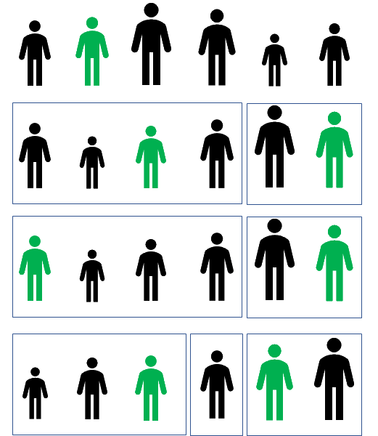
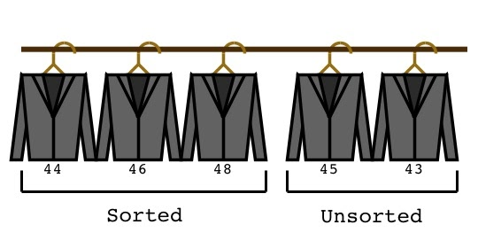
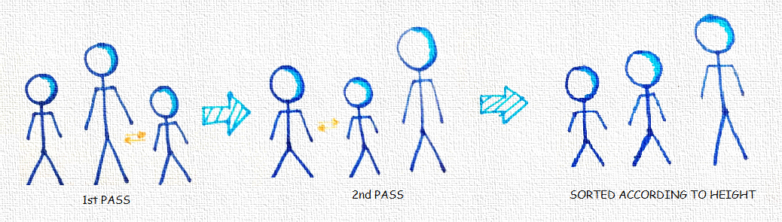
WHY DO WE NEED
SORTING ALGORITHMS ?
Notes:
A sorting algorithms will put items in a list into an order, such as alphabetical or numerical order.
For example, a list of customer names could be sorted into alphabetical order by surname, or a list of people could be put into numerical order by age.

Slide 5
DIFFERENT TYPES
OF
ALGORITHMS
MERGE SORT
HEAP SORT
SORTING ALGORITHMS
BUBBLE SORT
SELECTION SORT
INSERTION SORT
QUICK SORT

Slide 6
Why different types of Sorting Algorithm required ?
EVERY SORTING ALGORITHMS IS IMPORTANT ACCORDING IN HIS/HER OWN PURPOSE

Slide 7

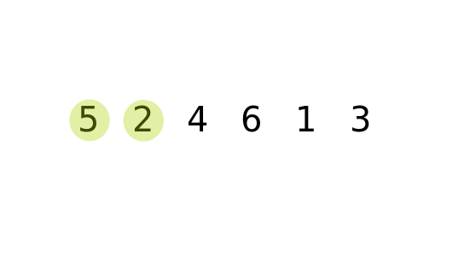
BUBBLE SORT
A slow sorting algorithm for the simplest data sets

Slide 8
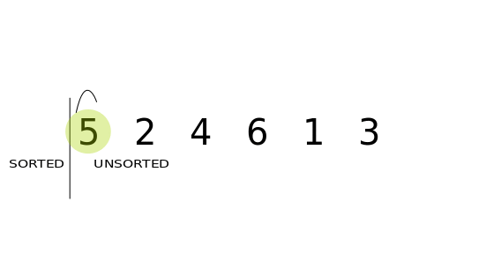
INSERTION SORT
Insertion sort is a simple sorting algorithm that works the way we sort playing cards. It is efficient for (quite) small data sets.

Slide 9

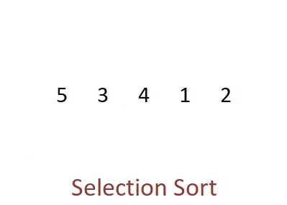
SELECTION SORT
Selection sort is noted for its simplicity, and it has performance advantages over more complicated algorithms in certain situations, particularly where auxiliary memory is limited

Slide 10

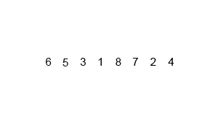
MERGE SORT
Merge Sort is a Divide and Conquer algorithm that continually splits a list in half and then merge the sublists in a sorted way.

Slide 11


QUICK SORT
Quick Sort is a recursive sorting algorithm that is more effective than other O(nlogn) algorithms for large datasets that fit in memory, but is unstable. Quick Sort in general does not requiere extra space while Merge Sort requires O(n) extra storage

Slide 12

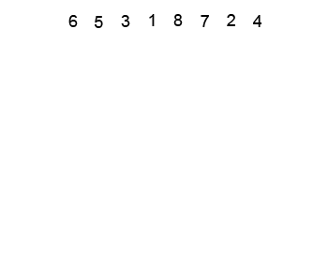
HEAP SORT
Heapsort is a comparison-based sorting algorithm. Heapsort can be thought of as an improved selection sort
The improvement consists of the use of a heap data structure rather than a linear-time search to find the maximum.

Slide 13
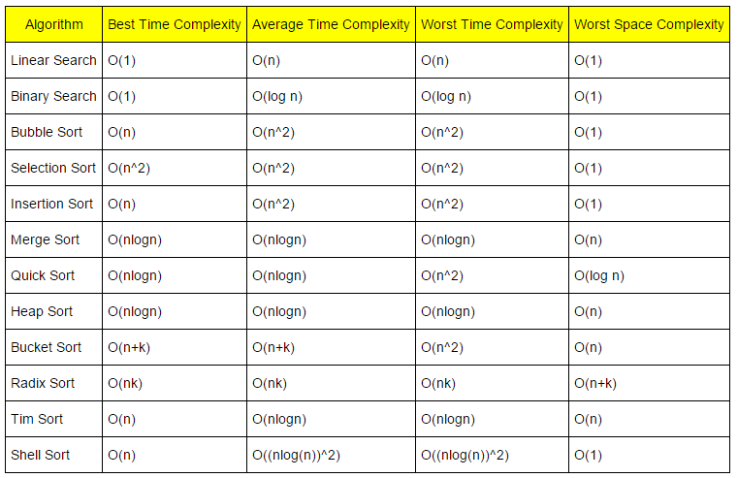

TIME & SPACE COMPLEXITY FOR VARIOUS SORTING ALGORITHMS

Slide 14
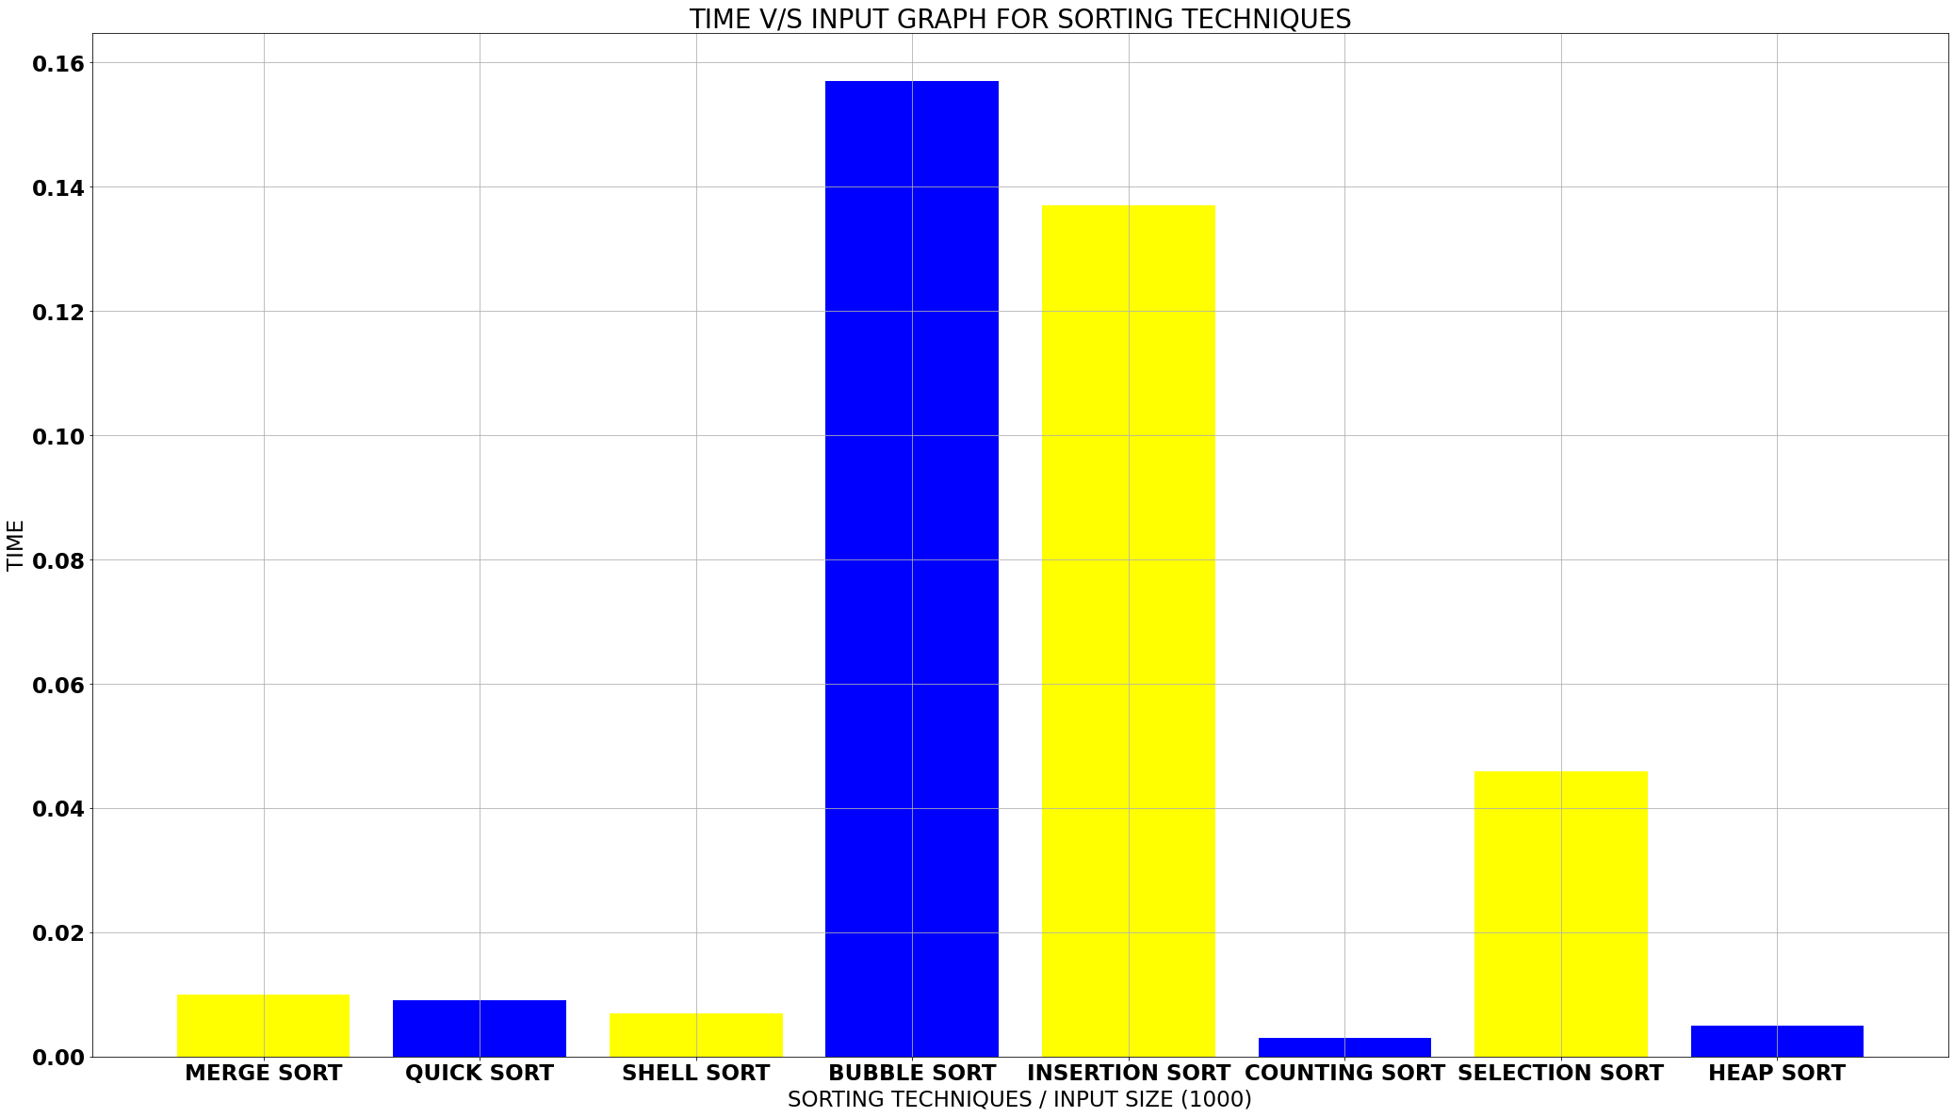
PROJECT RESULT & OUTCOME

Slide 15
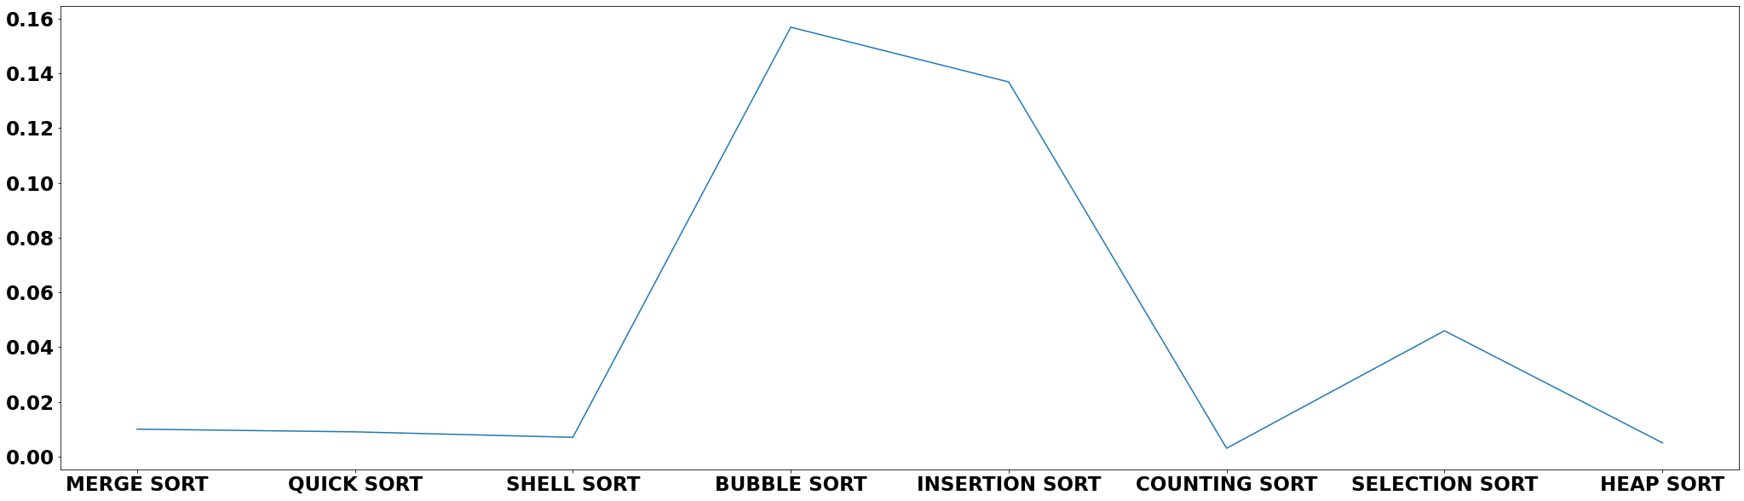
PROJECT RESULT & OUTCOME

Slide 16
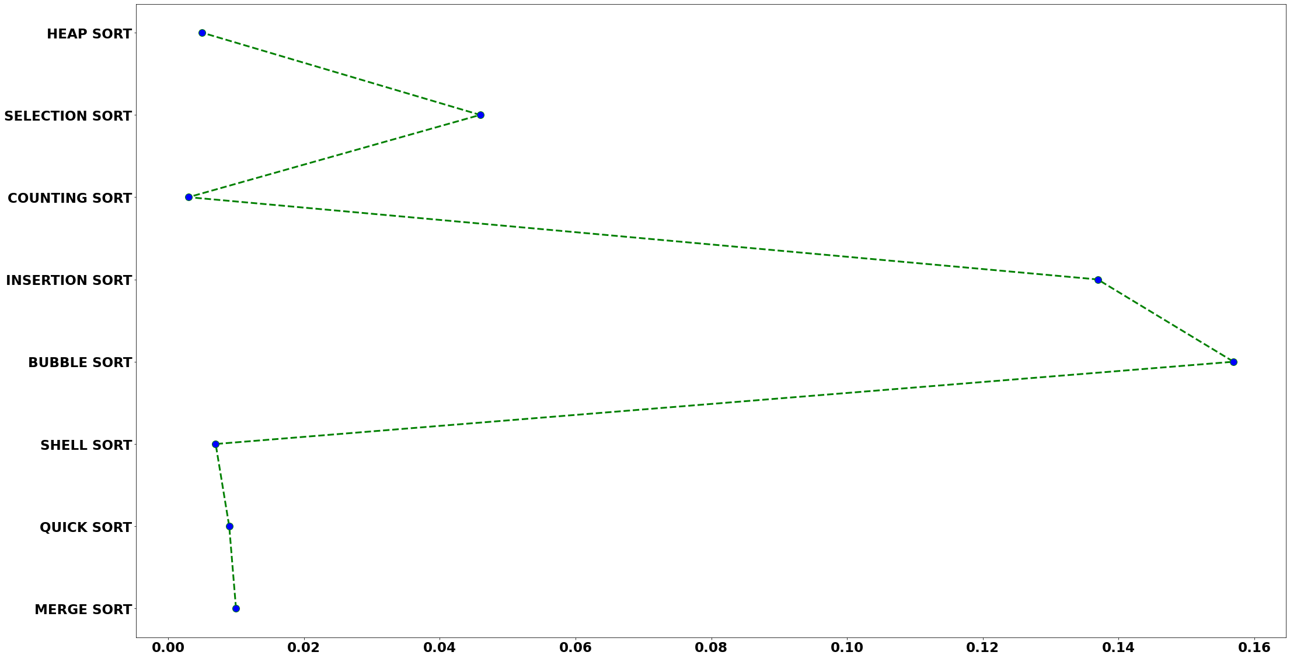
PROJECT RESULT & OUTCOME

Slide 17
Mini Project by :-
SHOURYA NAGPAL
University Roll Number -
19003200100154
CSE - C 2019B101103
3 rd Semester
ABES Engineering College

